Slide 1
CMSC 426 Principles of Computer Security
Malware Analysis

Slide 2
Last Class We Covered
Live demo of malware analysis
Types of malware
Well-known malware families
Gratuitous examples of malware

Slide 3
Any Questions from Last Time?

Slide 4
Today’s Topics
Malware analysis
Basic/advanced
Static/dynamic
Packing
Sandboxes
Malware signatures
Exam review and details

Slide 5
Malware Analysis

Slide 6
 | Static | Dynamic
Basic
Advanced
Looking at details of the malware when it is “at rest”
Running the malware and observing changes/output
ex: virusTotal, strings
ex: regShot, DebugView
Closely examining the malware’s code in detail
Running the malware and using a debugger to control details of its execution
ex: IDA Pro
ex: ollyDbg

Slide 7
Basic Static Analysis
Examining the malware while it is “at rest”
Plain-text strings within the code
Hashes (MD5, SHA-1, imphash, fuzzy)
Functions used (Windows API, etc.)
General information (malware type and family)
Other known instances of the malware

Slide 8
Basic Dynamic Analysis
Observing the output and/or changes when the malware is run
But not interfering or interacting with the malware
Debug/error messages the malware outputs
Changes to the registry

Slide 9
Advanced Static Analysis
Examining the malware’s code (assembly) in detail
Disassemblers organize the code into subroutines, and allow the analyst to more easily trace their way through the code
Much, much easier than reading the raw assembly
This information is normally used to inform what actions the analyst takes in the debugger

Slide 10
Advanced Dynamic Analysis
Using a debugger to control any and all aspects of the malware as it is being executed
Registers, stack, memory, and code
In the demo, we saw this used to “trick” the malware into accepting any incorrect password as correct

Slide 11
More Malware Analysis Info

Slide 12
Malware Packers
Goal is to obfuscate information about the malware
Code, strings, and sometime imports
Makes the malware more difficult to analyze
Does this by compressing and/or encrypting the malware
Simpler for the attackers than directly implementing protection within the code itself
Decrease chance of detection and increase amount of time/effort required for effective analysis
Information taken from https://securingtomorrow.mcafee.com/business/malware-packers-use-tricks-avoid-analysis-detection/

Slide 13
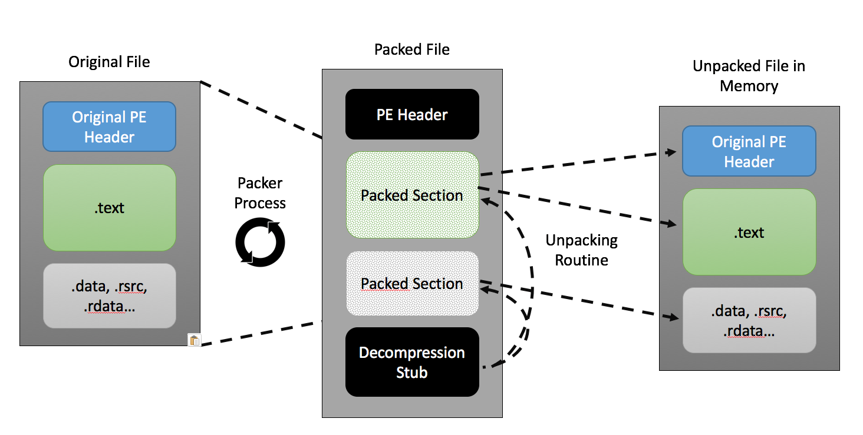
Malware Packer Example
Information taken from https://securingtomorrow.mcafee.com/business/malware-packers-use-tricks-avoid-analysis-detection/

Slide 14
Sandboxing
Automated technology for malware detection
Sandbox attempts to analyze the malware automatically
Place malware into a closed, controlled environment
Simpler setup; less complex environment
Reasons for using sandbox
Can’t cause any lasting damage
Easier to analyze
Information taken from https://www.apriorit.com/dev-blog/545-sandbox-evading-malware

Slide 15
Sandbox Evading
Malware can attempt to recognize if it’s in a sandbox
Won’t do anything malicious if it realizes this is the case
Some techniques include:
Not running unless certain dll files are available (many of which are not included in the sandbox)
Running at a specific date/time
Requiring user interaction (sandbox is automated)
Information taken from https://www.apriorit.com/dev-blog/545-sandbox-evading-malware

Slide 16
Malware Signatures vs Behavior
Two different aspects of malware that can be analyzed
Signature
Aspects of the malware that show up “at rest”
Strings and byte sequences
Behavior
Actions the malware takes when run
API functions called, etc.

Slide 17
Midterm Info and Review

Slide 18
Exam Rules
The midterm is closed everything:
No books
No notes
No cheat sheets
No laptops
No calculators
No phones

Slide 19
Exam Rules
Place your bag under your desk/chair
NOT on the seat next to you
You may have on your desk:
Pencils, erasers
You must use a pencil, not a pen
Water bottle
UMBC ID
You must bring your UMBC ID with you to the exam! We won’t accept your test without it.

Slide 20
Exam Rules
Your TA or instructor may ask you to move at any time during the test
This doesn’t mean we think you’re cheating
That being said, DO NOT CHEAT!!!
Cheating will be dealt with severely and immediately
There will be no retakes or partial credits

Slide 21
Exam Format
Multiple Choice
True/False
Short answer
Similar difficulty to questions on homeworks/labs

Slide 22
Exam Content
Heavy on stack overflow attacks, medium-light on malware
Very little you should need to memorize by rote
Not going to ask about many specific pieces of malware
Very few acronyms will be used
Exam is designed to test actual knowledge and understanding
If you didn’t complete Lab 1, talk to someone who did (or come to office hours)

Slide 23
Exam Advice
When you first get the exam...
Write down your name
Make sure your name is legible and on the line
Circle your section number
Read the Academic Integrity agreement
Sign your name underneath

Slide 24
Announcements
Paper 2 and 3 have been combined into one assignment – coming out next Wednesday, will have two weeks to complete
Lab 2 coming out later today
Midterm 1 is happening next class

